Slide 1

COVID-19 and the U.S. Economy
Benjamin Chang
Nicolas Min
Emmanuel Rodriguez

Slide 2
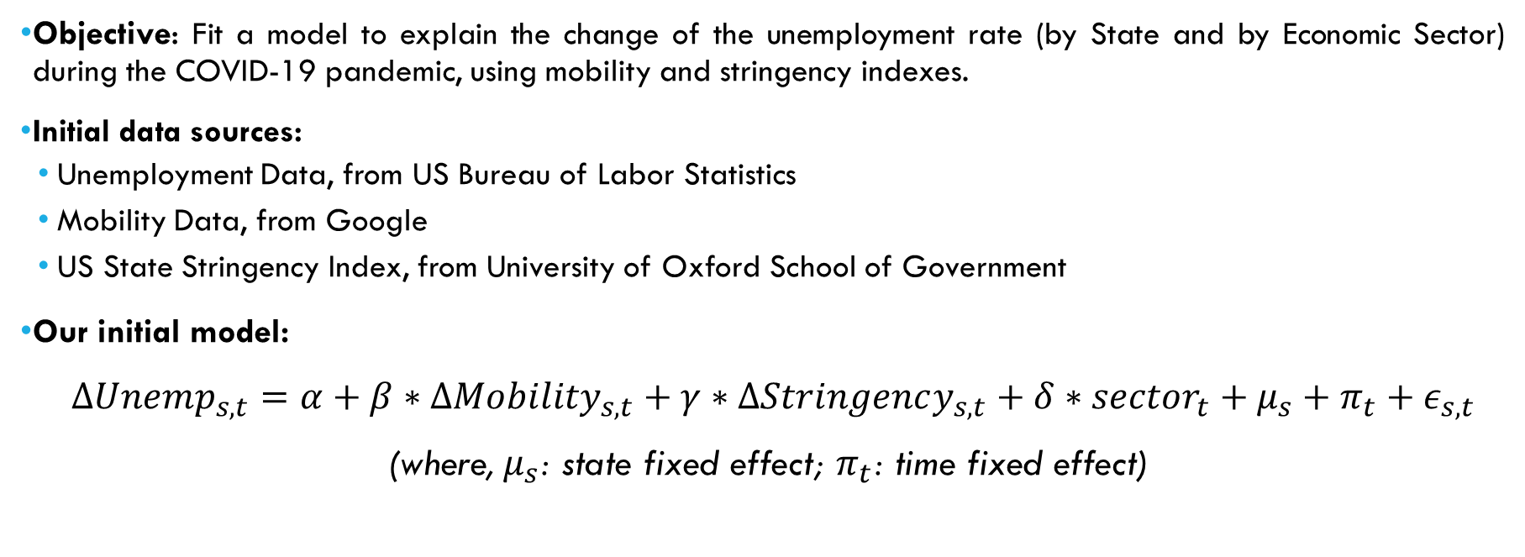
Where did we stay last time?
Objective: Fit a model to explain the change of the unemployment rate (by State and by Economic Sector) during the COVID-19 pandemic, using mobility and stringency indexes.
Initial data sources:
Unemployment Data, from US Bureau of Labor Statistics
Mobility Data, from Google
US State Stringency Index, from University of Oxford School of Government
Our initial model:
$ΔUnemp_{s,t}=α+β∗ΔMobility_{s,t}+γ∗ΔStringency_{s,t}+δ∗sector_{t}+μ_{s}+π_{t}+ε_{s,t}$
(where,${ μ}_{s}$: state fixed effect; $π_{t}$: time fixed effect)
Notes:
Emmanuel

Slide 3
Database Construction
First step. Consolidate all data in a single database.
Employment data
Update: Number of employees per state and per sector (thousands, SA), instead of unemployment rate
Source: US Bureau of Labor Statistics (https://download.bls.gov/pub/time.series/sm/sm.series)
Periodicity: Monthly
Rationale: There was no data on the unemployment rate by state and economic sector
$$ΔEmp_{state,t,sector}=\frac{Employees_{state, t,sector}}{Employees_{state, t−1,sector}}−1$$
Notes:
Emmanuel
Add plot from last time

Slide 4
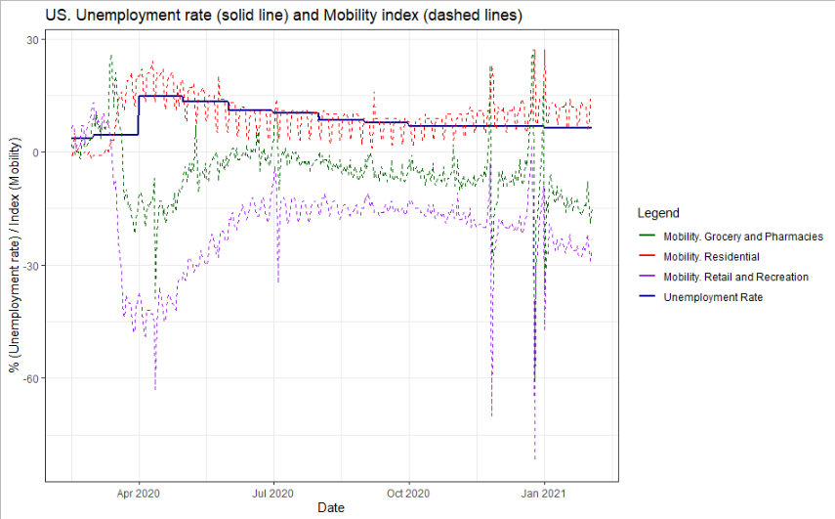
Database Construction
Mobility Data
The Residential Mobility index is taken as the Mobility index
Notes:
Emmanuel
Add plot from last time

Slide 5
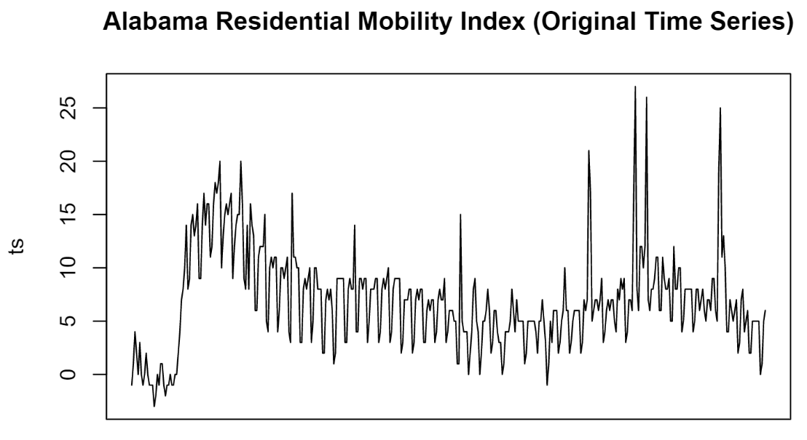
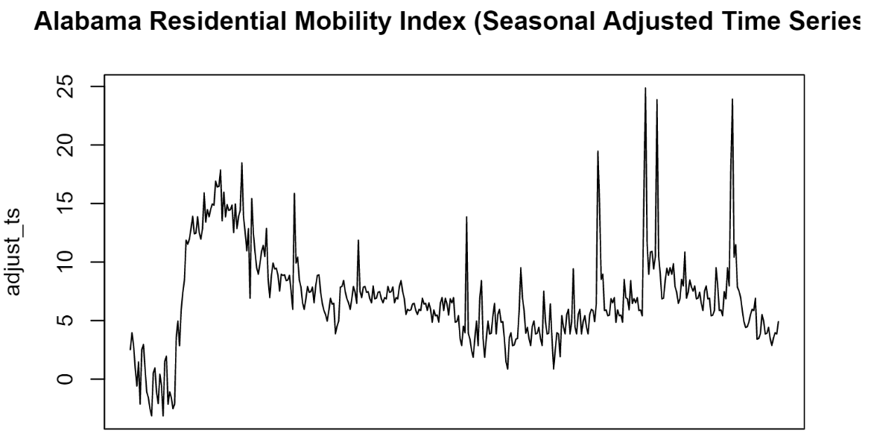

Database Construction
Mobility Data
Weekly seasonality adjustment, using additive model
Computation of the covariate
$$Original TS=Trend+Seasonal+Random$$
$$Seasonal Adjusted TS=Original TS −Seasonal$$
$$ΔMobility_{state, t}=\frac{SA Res Mobility_{state,t}}{SA Res Mobility_{state,t−1}}−1$$
Notes:
Emmanuel
Add plot from last time

Slide 6
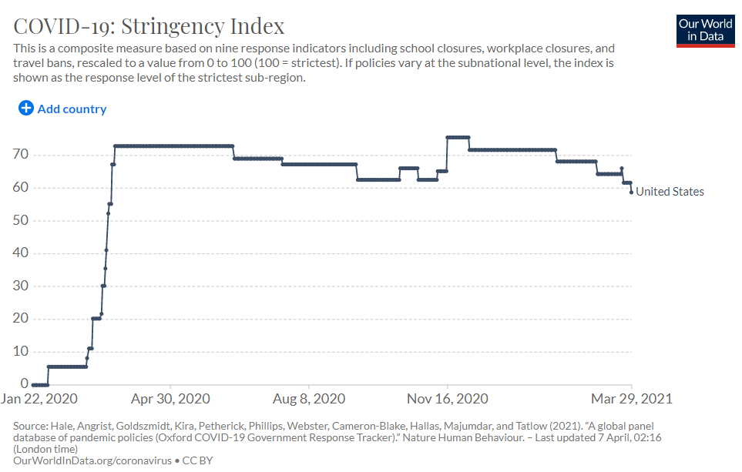
Database Construction
Stringency Data
Range of the Stringency Index: 0-100
Computation of the covariate
$$ΔStrin_{state,t}=Strin_{state,t}−Strin_{state,t−1}$$
Notes:
Emmanuel
Add plot from last time

Slide 7
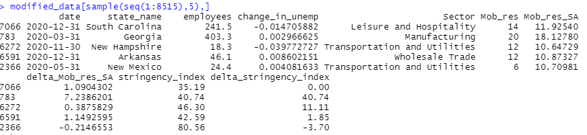
Database Construction
Output
12 months: March 2020 – February 2021
50 states + Washington DC
12 economic sectors: Manufacturing, Mining and Logging, Construction, Education and Health Services, Retail Trade, Financial Acitivities, Wholesale Trade, Information, Professional and Business Services, Leisure and Hospitality, Transportation and Utilities, and Government
Notes:
Emmanuel
Add plot from last time

Slide 8
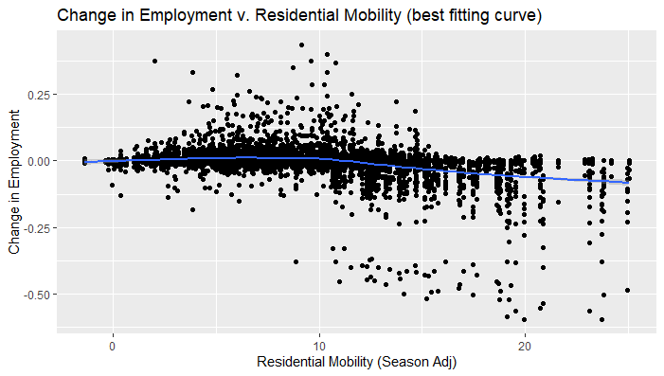
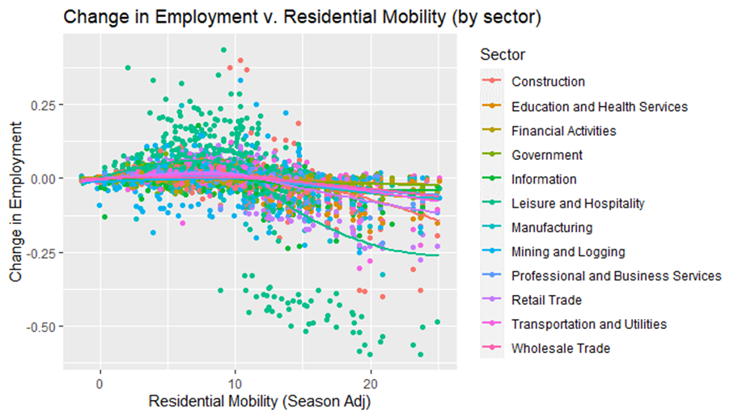
Change in employment (mobility)
Depicts the best fitting curve from all sectors and dates combined
Trend a bit sinusoidal
Different sectors have different trends
Leisure & Hospitality has a sinusoidal curve
Other sectors have a flat line
Notes:
If we wanna show sinusoidal, we should have emp v. mobility here (not mobility squared).

Slide 9
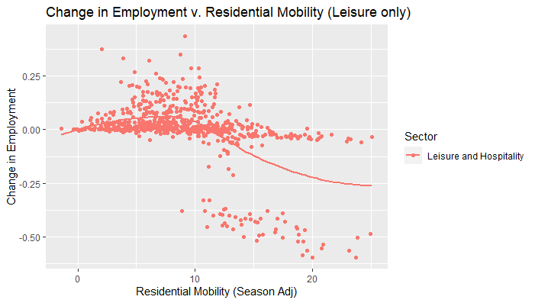
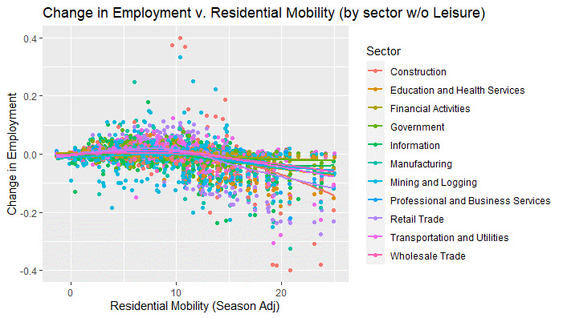
Change in employment (mobility)
For our model:
Create function to model for different sectors in our model
Interaction term between sector and mobility
Notes:
Change to mobility (not mobility squared)
Add non-leisure
Also show just the leisure (to make a point that it sticks out)

Slide 10
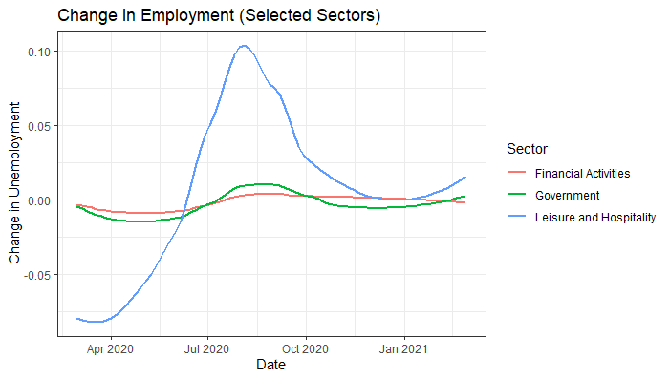
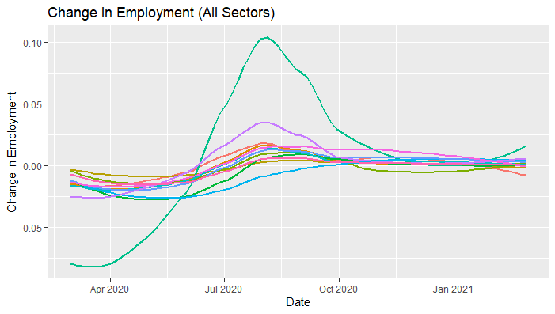
Change in employment (sector)
Different sectors have different employments
Leisure & Hospitality had the largest change over time
Different sectors have different patterns
Use different functions to model change in employment

Slide 11
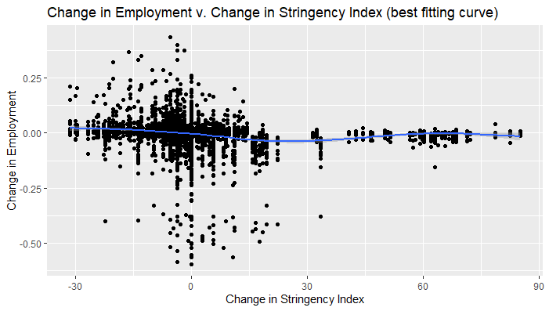
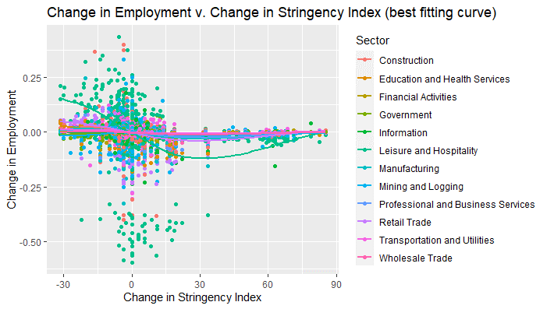
Change in employment (stringency)
Fairly linear relationship between stringency and change in employment
Tried using polynomial terms for stringency
Linear correlation between stringency and mobility (ρ= 0.67)
Different sectors have different trends
Interaction term between sector and stringency

Slide 12
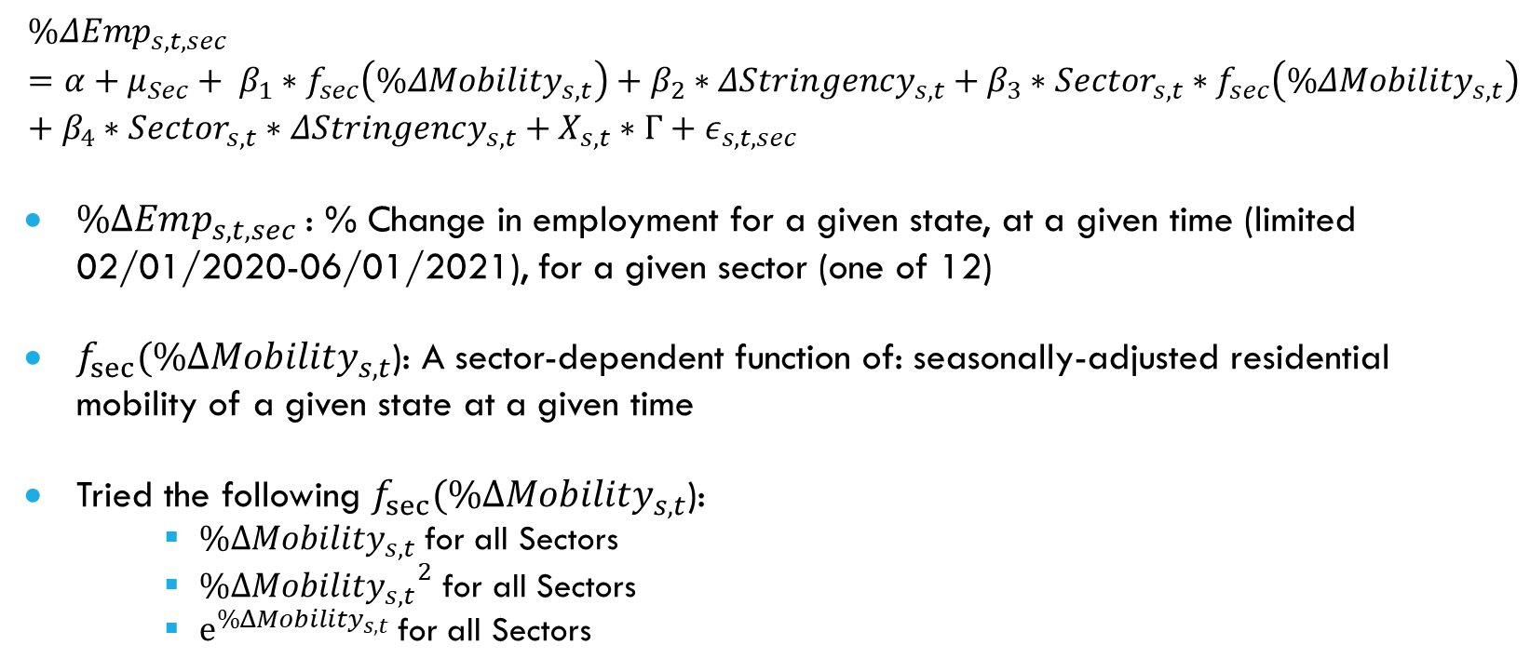
Our Model
$$\%ΔEmp_{s,t,sec}=α+{μ_{Sec}+ β}_{1}∗f_{sec}\left(\%ΔMobility_{s,t}\right)+β_{2}∗ΔStringency_{s,t}+β_{3}∗Sector_{s,t}∗f_{sec}\left(\%ΔMobility_{s,t}\right)+β_{4}∗Sector_{s,t}∗ΔStringency_{s,t}+X_{s,t}∗Γ{+ ε}_{s,t,sec}$$
$\%ΔEmp_{s,t,sec}$: % Change in employment for a given state, at a given time (limited 02/01/2020-06/01/2021), for a given sector (one of 12)
$f_{sec}(\%ΔMobility_{s,t}$): A sector-dependent function of: seasonally-adjusted residential mobility of a given state at a given time
Tried the following $f_{sec}(\%ΔMobility_{s,t}$):
$\%ΔMobility_{s,t}$for all Sectors
${\%ΔMobility_{s,t}}^{2}$ for all Sectors
$e^{\%ΔMobility_{s,t}}$for all Sectors

Slide 13
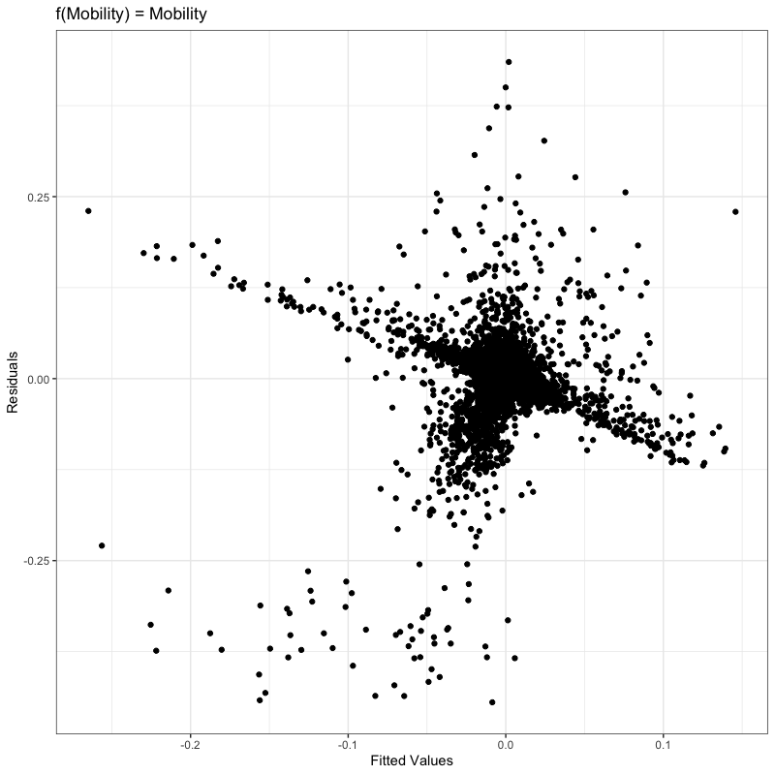
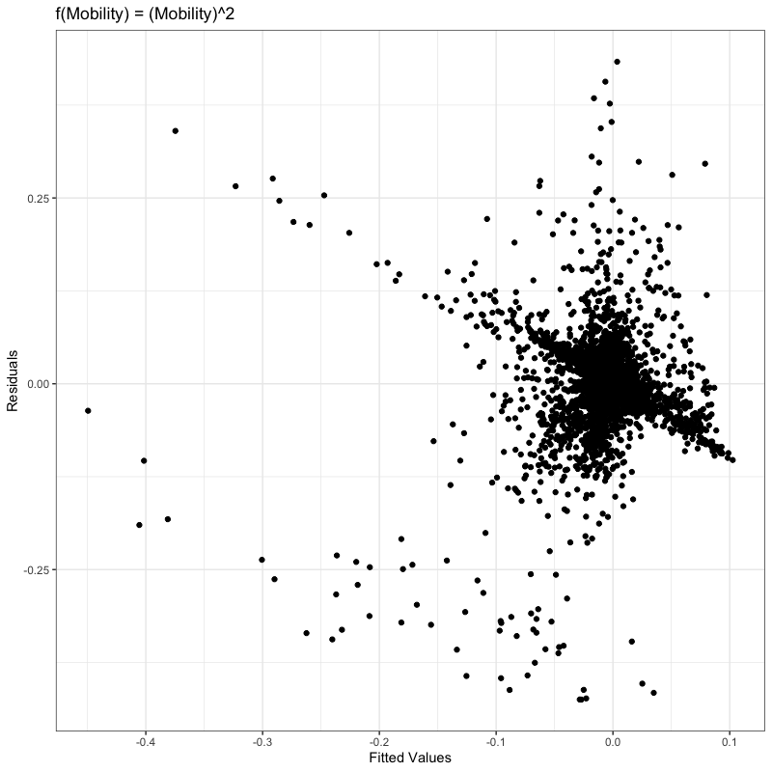
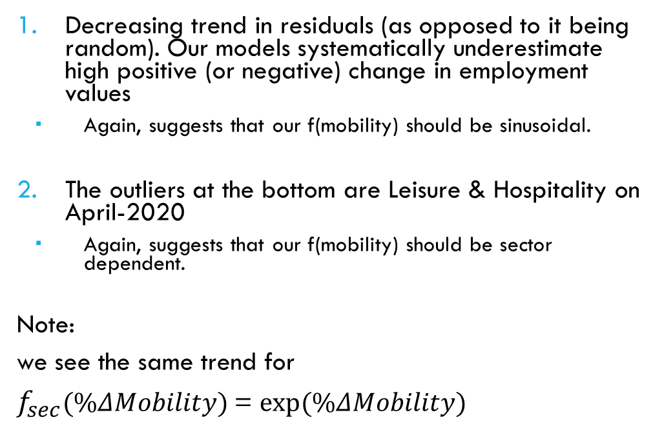
Residual Analysis
Decreasing trend in residuals (as opposed to it being random). Our models systematically underestimate high positive (or negative) change in employment values
Again, suggests that our f(mobility) should be sinusoidal.
The outliers at the bottom are Leisure & Hospitality on April-2020
Again, suggests that our f(mobility) should be sector dependent.
Note:
we see the same trend for
$f_{sec}(\%ΔMobility)$= $exp⁡(\%ΔMobility)$

Slide 14
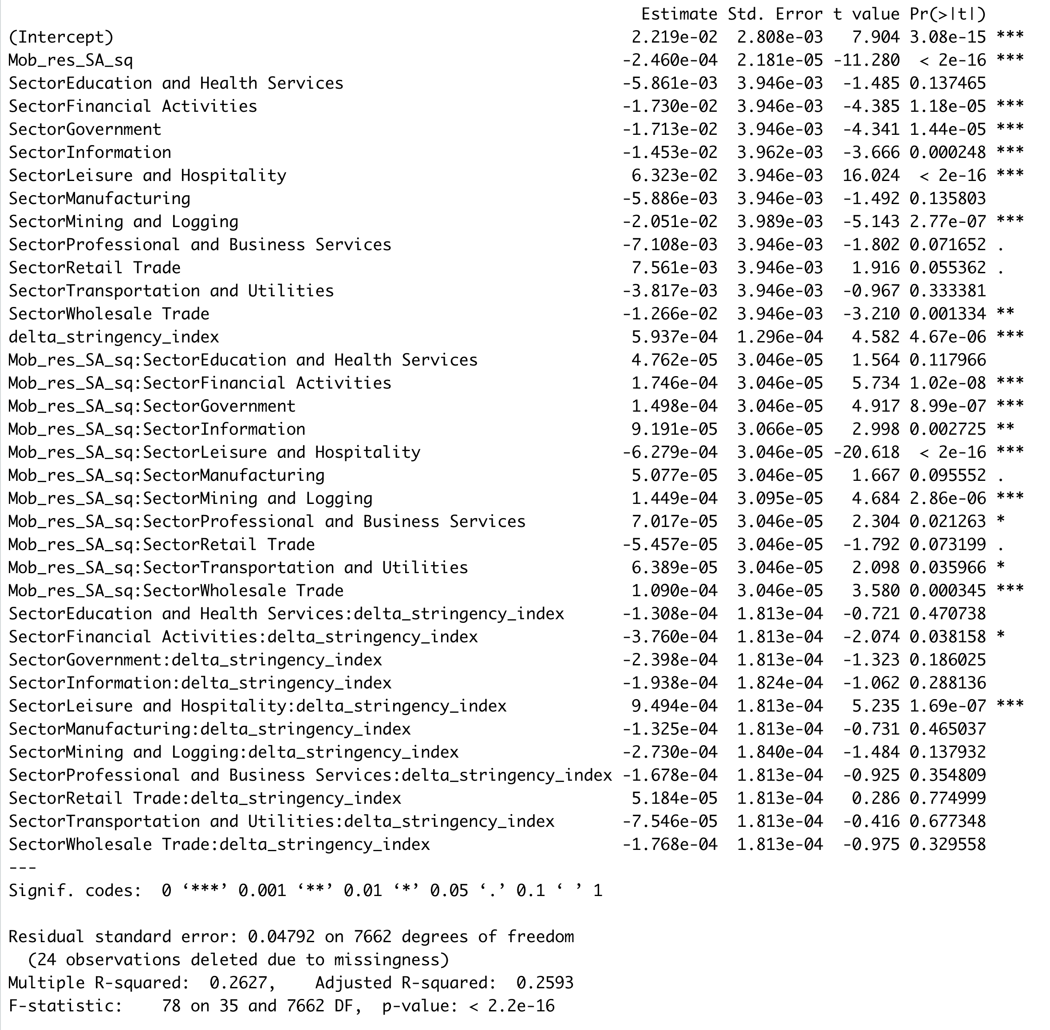
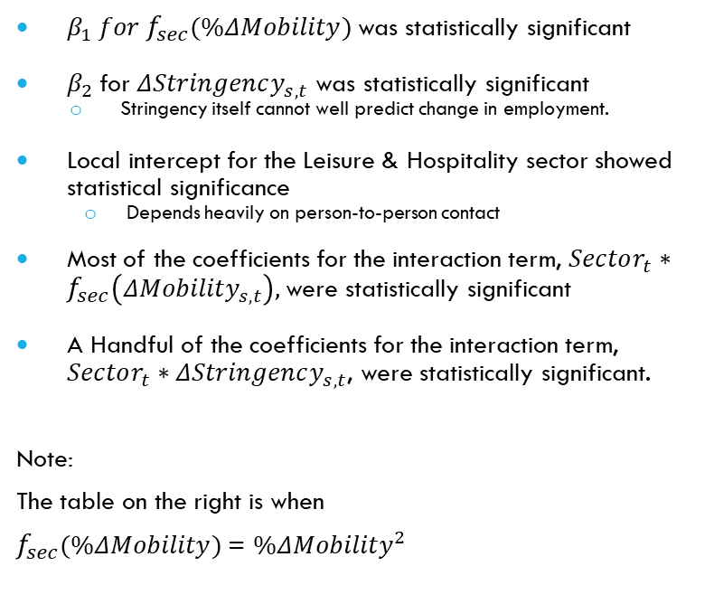
Coefficients (DRAFT)
$β_{1} for f_{sec}(\%ΔMobility)$was statistically significant
$β_{2}$for $ΔStringency_{s,t}$ was statistically significant
Stringency itself cannot well predict change in employment.
Local intercept for the Leisure & Hospitality sector showed statistical significance
Depends heavily on person-to-person contact
Most of the coefficients for the interaction term, $Sector_{t}∗f_{sec}\left(ΔMobility_{s,t}\right),$were statistically significant
A Handful of the coefficients for the interaction term, $Sector_{t}∗ΔStringency_{s,t}$, were statistically significant.
Note:
The table on the right is when
$f_{sec}(\%ΔMobility)$= $\%ΔMobility^{2}$
Notes:
MENTION: do not focus on R-sq or the numbers itself.

Slide 15
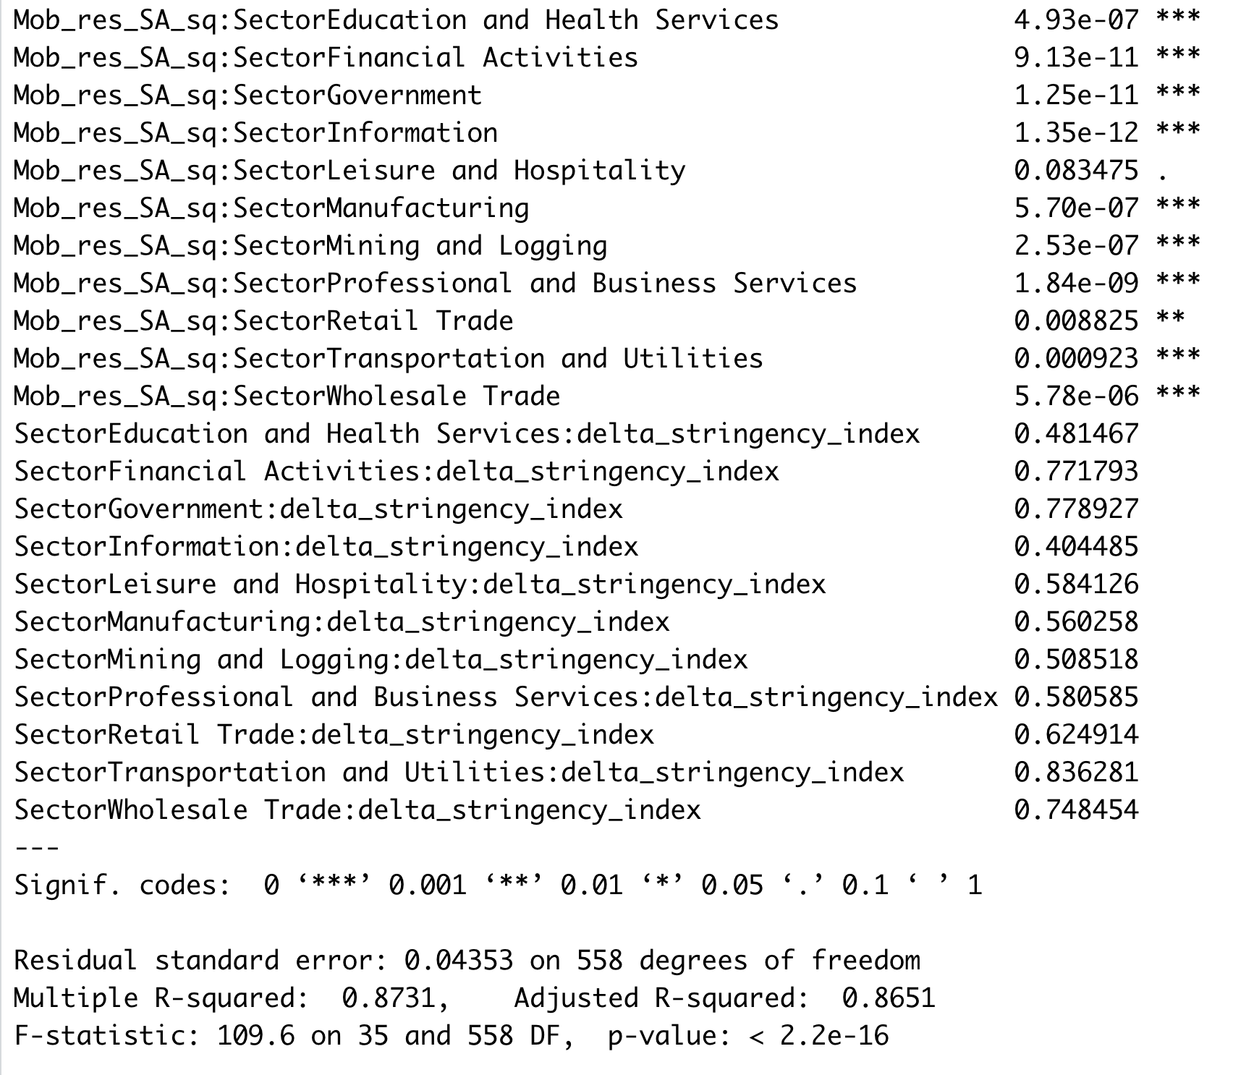
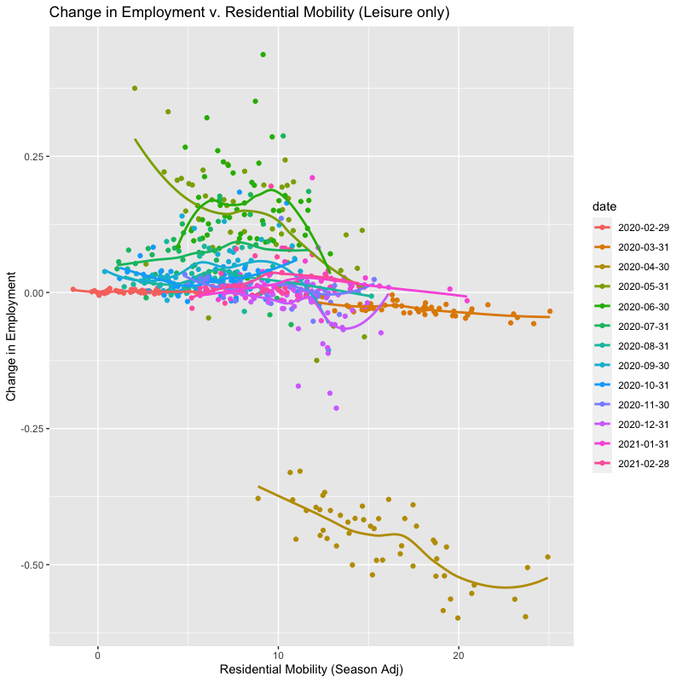
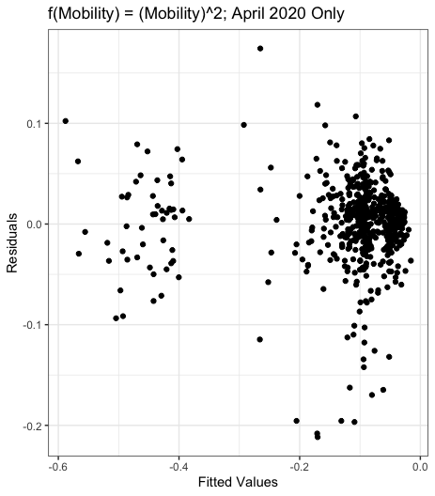
A Challenge
If we apply the model to “April 2020” only, the performance of our model increases dramatically. (R-sq = 0.8651)
The performance does not dramatically increase if we apply the model to “March 2020” only (R-sq = 0.4173)
So, we need date interactions too.
However, our numbers are seasonally adjusted and we are contriving a predictive model, so including date in our model is impertinent.
Two options:
Drop April 2020 Data.
Include New COVID-19 cases data as control variable.
Notes:
This is not unique to leisure!
Stringency plot will show the same thing!!

Slide 16
Future Work & Final Direction
Enhance our model:
Fix the date-interaction issue.
Find the sector-dependent f(%change in mobility) to capture the deep fluctuation in change in employment.
Investigate possible effects of lead/lag of f(%change in mobility) on change in employment
Add more control variables to our model
New COVID cases, share of elderly people, 2016 Trump Vote share
Prediction:
Using Cross-Validation (stratified, so that Leisure & Hospitality samples are included in both the training & validation set) , find the optimal coefficients. Then, predict April/May 2021 change in employment data
Finally, evaluate our prediction by computing the RMSE between the predicted and the real values

